Slide 1

Resistors and resistance

Slide 2
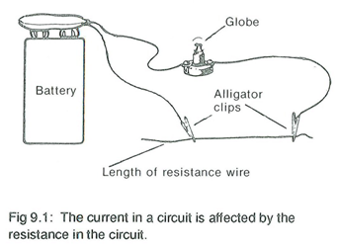
Resistors and resistance
If a light globe, a cell and a piece of resistance wire are connected together as in the diagram below, the globe can be made to glow brightly or to barely light up depending upon the length of resistance wire used. When a long length of resistance wire is used the globe hardly glows but when a short piece is used, the globe glows brightly.

Slide 3
The short length of resistance wire does not ‘resist’ the movement of charge very much. However, when the resistance wire is made longer the resistance to the flow of electricity is increased. Not as much current flows and the globe barely lights up. The long wire limits the flow of current and it is said that the wire has a larger resistance. As the amount of resistance in a wire increases, the current that flows decreases.
The current flow depends upon the driving force or voltage which is applied to a circuit and to the resistance in the circuit.
Resistance is measured in units called ohms. The symbol for an ohm is Ω. Large values of resistance usually have prefixed. One thousand ohms is represented by one kilohm (kΩ) and one million ohms is the same as one megaohm (MΩ).

Slide 4
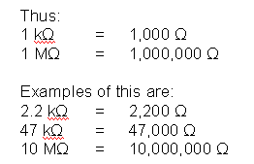
Resistance of materials
The resistance of a conductor depends upon the type of material it is made from, its length and its thickness.

Slide 5
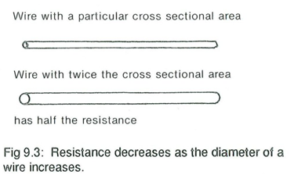

Slide 6
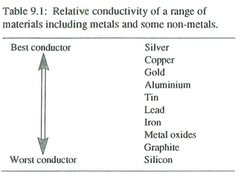
All conductors try to reduce current. The amount that current is reduced by a material is related to how easily electrons are able to move in the conductor. Table 9.1 shows how well different conductors carry electricity, from best conductors to worst conductors

Slide 7
Resistors which are affected by the amount of light falling on them are called light dependent resistors or LDRs and are made from cadmium sulphide. Another group of resistors which are very sensitive to temperature changes are called thermistors. These are made from various semiconducting materials.
Types of resistors
Resistors are of two main types, fixed resistors and variable resistors. Variable resistors are often referred to as potentiometers or, in circuits which draw very large currents, they are called rheostats.
Fixed resistors
There are three main types of fixed resistors: wire wound, carbon and metal oxide.
Wire wound resistors
Wire wound resistors have a length of resistance wire wrapped around a plastic or ceramic core. The wire is connected to the two resistor leads and coated with an insulating plastic. In this type of resistor, the value is usually written on the protective coating. Wire wound resistors are used when extremely accurate and high wattage values are needed.

Slide 8
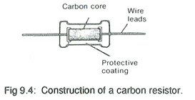
Carbon resistors
Carbon resistors are made in one of two ways. Some have a central core made of carbon or carbon mixed with another material, while others have an insulating central core with a carbon coating on the outside of the core. In both systems, the two resistor leads are connected to the ends of the carbon material and are then coated for protection.

Slide 9
Carbon resistors are not as accurate as wire wound or metal oxide resistors but they are very cheap to produce and are widely used in electronics. Carbon resistors with values from 1 Ω to 10 MΩ are made and the value of each is shown using a four band colour coding system.
Metal oxide resistors
Metal oxide resistors are made in a similar manner to carbon resistors, except that certain metal oxides are used instead of carbon. They are usually coated in a grey coloured material and are more accurate. To allow for the value of these resistors to be shown a five band colour coding system is used.

Slide 10
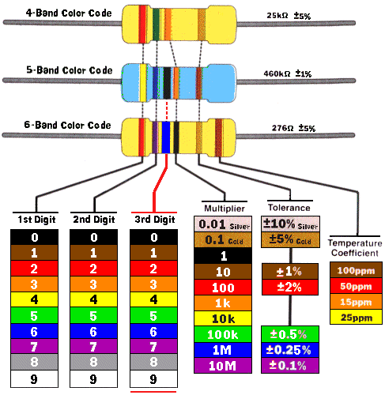

Slide 11
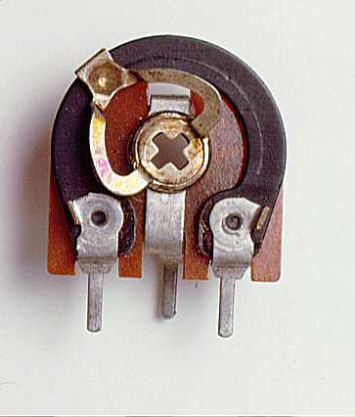
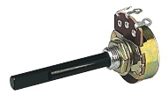
Variable Resistors
Potentiometers
Potentiometers work on the principle that longer lengths of resistance material have greater resistance. Potentiometers usually have three connecting points. Two are connected to the ends of the resistance material and the third is connected to the central sliding contact. The slider can either slide in a straight line or around a curve. This is shown in Figure 9.5.

Slide 12
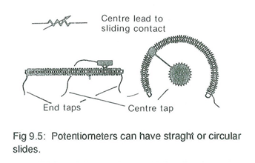
Thin resistance wire, or a strip of carbon material, is used in potentiometers where small amounts of current are required. However, in potentiometers where large currents are necessary, such as in those used for light dimmers in theatres, very thick resistance wire is used. Large potentiometers used in applications such as this are called rheostats.
Preset resistors
Preset resistors operate on the same principle as potentiometers except the value is usually adjusted when a circuit is being tested and then left on that setting. They are usually adjusted by using a small screwdriver.

Slide 13
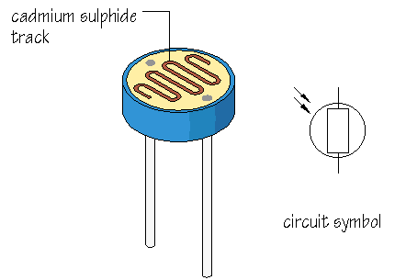
Light dependent resistors (LDRs)
Light dependent resistors are made from a semiconductor called cadmium sulphide. The resistance of this material changes according to the amount of light falling on it. The letters LDR are used to represent a light dependent resistor.

Slide 14
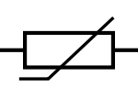
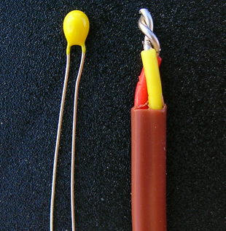
Thermistors
Thermistors are also made from a semiconducting material. However, in thermistors, the resistance varies with temperature. Generally, as their temperature increases, resistance falls. Thermistors are usually small discs or beads

Slide 15
Uses of resistors
Resistance is used to control the flow of electric current. When current flows through a resistor, heat is produced. In electrical appliances, this heat can be used to boil water or heat rooms. However, in many places where resistors are used, the heat generated is not wanted. In these circuits they are used to control the current flow. The heat produced is simply energy.
Fixed resistors are used in radios, televisions, computers, amplifiers, tape recorders and most other modem electrical appliances to control current. In heaters and light globes, the heating and lighting effect of electricity is used.
Potentiometers and rheostats are used in the volume control of radios, televisions and tape recorders. They are also used in the contrast and colour control of televisions, and in light dimmers, such as the dash light in a car.
Light dependent resistors are used in light meters and in circuits designed to switch on or off when light intensity changes, such as entrance alarm systems.
Thermistors are used for temperature measurement and also in alarm circuits, such as fire or ice alarms.

Slide 16

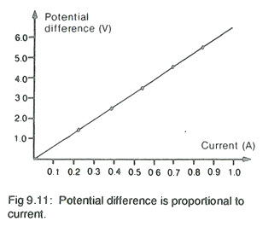
Ohm's law
The current flowing in a circuit is affected by the resistance of the circuit and the driving force, or voltage, applied. To investigate this relationship the arrangement shown in Figure 9.10 can be used

Slide 17
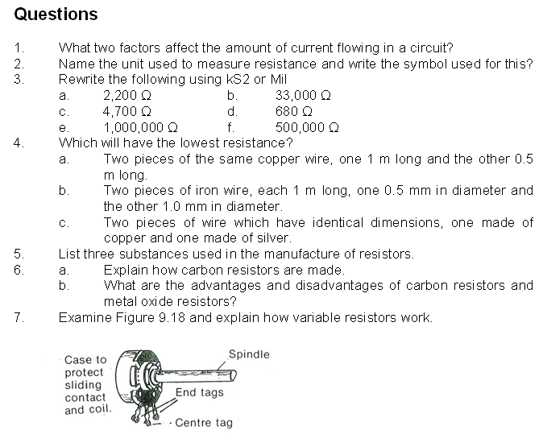

Slide 18
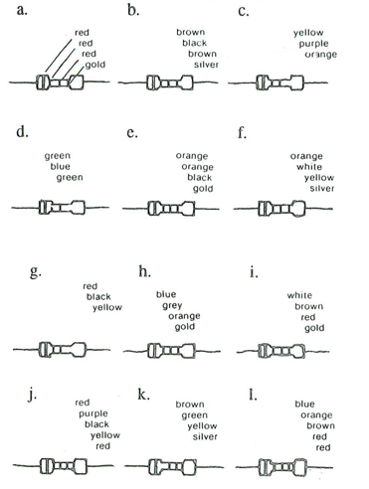

Slide 19
State the colours of the bands for each of the following resistors.
a. 18 Ω 5% carbon film
b. 270 Ω 10% carbon film
c. 8.2 kΩ 10% carbon film
d. 8.20 kΩ 1% metal oxide
e. 470 kΩ 1% metal oxide

